Slide 1
Momentum and Mean reversion strategy with CDX IG
CASE Study question 1-e
Author: cici chen

Slide 2
Basic Implementation detail
Both Models includes 4 trade parameter which we optimize in order to achieve the maximum Sharpe ratio
Lookback Period: the rolling window for computing spread moving average and z-score
Hedge Ratio: Spread is computed as the return difference between 1 unit of CDX IG and hedge ratio unit of SPX/VIX the ratio, each time there is a trading signal, we long/short the spread proportionally
Entrance Threshold: The threshold value where we buy or short the spread base on our strategy
Exit Threshold: The threshold where we clear our positions to 0
Modell Assumption:
We only hold +1/-1/0 amount of CDX IG Bond, so the portfolio is scalable
We compare z-score of CDX IG – SPX spread with entrance/exit threshold to generate trading signals for mean reversion strategy
We compare the rolling moving average of CDX – VIX spread with current spread to generate trading signals for momentum strategy

Slide 3
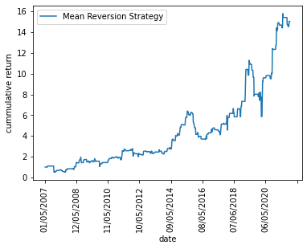
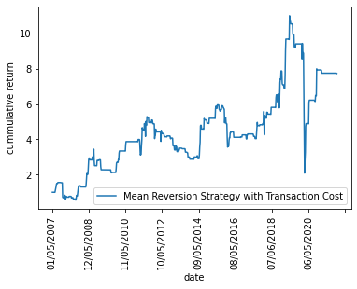
Mean Reversion
No Transaction Cost
Best Trade Parameters : lookback = 8W, hedge ratio = 0.80, entry threshold =0.8, exit threshold = entry threshold* -0.2
Performance Metrics:
Annualized Mean: 25.74%
Annualized Std: 37.62%
Annualized Sharpe: 0.684
max draw down = -44%, Max draw down duration = 144 weeks
Weekly 5% var = -5%, Weekly 5%CVAR = -11.8%
With Transaction Cost
Best Trade Parameters : lookback = 104W, hedge ratio = 0.80, entry threshold =1, exit threshold = entry threshold* -0.2
Performance Metrics:
Annualized Mean: 23.91%
Annualized Std: 63.26%
Annualized Sharpe: 0.553
max draw down = -74%, Max draw down duration = 184 weeks
Weekly 5% var = -4.96%, Weekly 5%CVAR = -13.5%

Slide 4
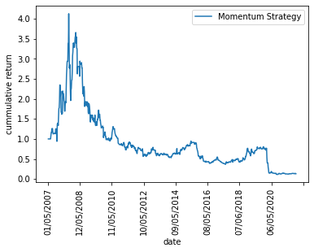
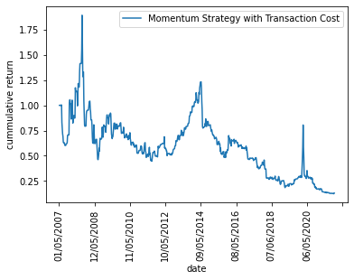
Momentum
No Transaction Cost
Best Trade Parameters : lookback = 156W, hedge ratio = 0.8, entry threshold =0.005, exit threshold = entry threshold* 1.2
Performance Metrics:
Annualized Mean: 34.6%
Annualized Std: 67.1%
Annualized Sharpe: 0.516
max drawdown = -58.0%, Max drawdown duration =163 weeks
Weekly 5% var = - 11.6%, Weekly 5%CVAR = -17.2%
With Transaction Cost
Best Trade Parameters : lookback = 156W, hedge ratio = 0.8, entry threshold =0.005, exit threshold = entry threshold* 1.2
Performance Metrics:
Annualized Mean: 34.3%
Annualized Std: 67.1%
Annualized Sharpe: 0.513
max drawdown = -57.8%, Max drawdown duration = 163weeks
Weekly 5% var = -11.8%, Weekly 5%CVAR = -17.2%

Slide 5
Summary
Mean Reversion Strategy has higher Sharpe Ratio given smaller volatility, Momentum Strategy has high return with high volatility thus result in a lower Sharpe ratio and higher VaR/CVaR
Both strategies looks profitable, however I would not recommend the model consider the opportunity cost, and the transaction costs. When comparing the strategy with investing only in CDX IG which gives us a Sharpe Ratio of 2.41. We can see that we are taking excess risk with no additional return
The weekly CVaR and Maximum Drawdown of the strategies are very negative, given such large risks with small returns, neither of the model would be ideal for the Pension Plan
Future improvement:
Change Rebalance Frequency: we can try daily rebalancing to seize the opportunity of mean reversion/momentum within the week
Instead of only having +1/-1/0 as holding position for CDX IG, in the future we could have position in proportional to trade signal, if the signal is significantly then we would increase the position correspondingly
Currently we are using all sample data to train the trading parameter, we could split the data into training and test sets and optimize trade parameters base on the Sharpe ratio of test set to avoid over-fitting bias

